Slide 2
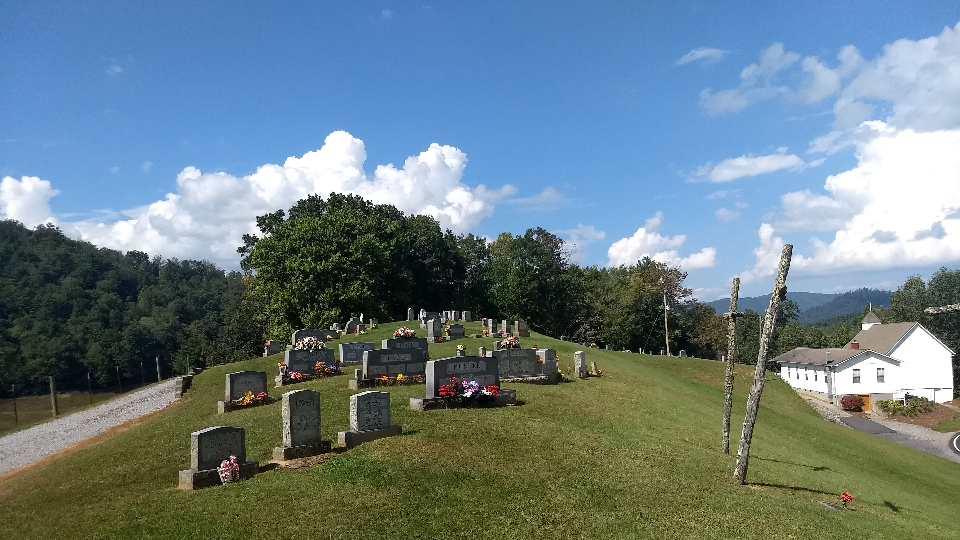

Slide 3
The Announcement

Slide 4
Who was John the Baptist?
[Mat 3:1-6] “¹ In those days came John the Baptist, preaching in the wilderness of Judaea, ² And saying, Repent ye: for the kingdom of heaven is at hand.

Slide 5
Who was John the Baptist?
³ For this is he that was spoken of by the prophet Esaias, saying, The voice of one crying in the wilderness, Prepare ye the way of the Lord, make his paths straight. ⁴ And the same John had his raiment of camel’s hair, and a leathern girdle about his loins; and his meat was locusts and wild honey.

Slide 6
Who was John the Baptist?
⁵ Then went out to him Jerusalem, and all Judaea, and all the region round about Jordan, ⁶ And were baptized of him in Jordan, confessing their sins.”
Matthew 3:1-6

Slide 7
What did John say when Jesus came to the river?
“The next day John seeth Jesus coming unto him, and saith, Behold the Lamb of God, which taketh away the sin of the world.”
John 1:29

Slide 8
What did it mean, the “lamb?”
“⁷ And Isaac spake unto Abraham his father, and said, My father: and he said, Here am I, my son. And he said, Behold the fire and the wood: but where is the lamb for a burnt offering? ⁸ And Abraham said, My son, God will provide himself a lamb for a burnt offering: so they went both of them together.” Genesis 22:7-8

Slide 9
What would He do?
[Isa 53:4-7] “⁴ Surely he hath borne our griefs, and carried our sorrows: yet we did esteem him stricken, smitten of God, and afflicted. ⁵ But he was wounded for our transgressions, he was bruised for our iniquities: the chastisement of our peace was upon him; and with his stripes we are healed.
Notes:
“take away” = bear away

Slide 10
What would He do?
⁶ All we like sheep have gone astray; we have turned every one to his own way; and the Lord hath laid on him the iniquity of us all. ⁷ He was oppressed, and he was afflicted, yet he opened not his mouth: he is brought as a lamb to the slaughter, and as a sheep before her shearers is dumb, so he openeth not his mouth.” Isaiah 53:4-7
Notes:
“take away” = bear away

Slide 11
A Redeemer

Slide 12
What is sin?
“Whosoever committeth sin transgresseth also the law: for sin is the transgression of the law.” 1 John 3:4

Slide 13
What one sin brought this world down?
“And when the woman saw that the tree was good for food, and that it was pleasant to the eyes, and a tree to be desired to make one wise, she took of the fruit thereof, and did eat, and gave also unto her husband with her; and he did eat.” Genesis 3:6

Slide 14
What comes as a consequence of sin?
“Wherefore, as by one man sin entered into the world, and death by sin; and so death passed upon all men, for that all have sinned.” Romans 5:12

Slide 15
What else happened to us in consequence of sin?
[Rom 8:5-8] “⁵ For they that are after the flesh do mind the things of the flesh; but they that are after the Spirit the things of the Spirit. ⁶ For to be carnally minded is death; but to be spiritually minded is life and peace.

Slide 16
What else happened to us in consequence of sin?
⁷ Because the carnal mind is enmity against God: for it is not subject to the law of God, neither indeed can be. ⁸ So then they that are in the flesh cannot please God.” Romans 8:5-8

Slide 17
What does it mean to be “in the flesh?”
“¹⁹ Now the works of the flesh are manifest, which are these; Adultery, fornication, uncleanness, lasciviousness, ²⁰ Idolatry, witchcraft, hatred, variance, emulations, wrath, strife, seditions, heresies, ²¹ Envyings, murders, drunkenness, revellings, and such like: of the which I tell you before, as I have also told you in time past, that they which do such things shall not inherit the kingdom of God.” Galatians 5:19-21

Slide 18
What hope can there be in this situation?
“⁸ But God commendeth his love toward us, in that, while we were yet sinners, Christ died for us. ⁹ Much more then, being now justified by his blood, we shall be saved from wrath through him. ¹⁰ For if, when we were enemies, we were reconciled to God by the death of his Son, much more, being reconciled, we shall be saved by his life.” Romans 5:8-10

Slide 19
How much can you pay to be right with God?
“¹⁸ Forasmuch as ye know that ye were not redeemed with corruptible things, as silver and gold, from your vain conversation received by tradition from your fathers; ¹⁹ But with the precious blood of Christ, as of a lamb without blemish and without spot.”
1 Peter 1:18-19

Slide 20
If you don’t pay, how do you receive it?
“For by grace are ye saved through faith; and that not of yourselves: it is the gift of God.” Ephesians 2:8

Slide 21
The Work of Grace

Slide 22
What does grace first do for us?
“Or despisest thou the riches of his goodness and forbearance and longsuffering; not knowing that the goodness of God leadeth thee to repentance?” Romans 2:4

Slide 23
What else does grace do?
“That being justified by his grace, we should be made heirs according to the hope of eternal life.” Titus 3:7

Slide 24
What does that make us?
“To the praise of the glory of his grace, wherein he hath made us accepted in the beloved.” Ephesians 1:6

Slide 25
How does it help us in our daily life?
“Wherefore we receiving a kingdom which cannot be moved, let us have grace, whereby we may serve God acceptably with reverence and godly fear.” Hebrews 12:28

Slide 26
What kind of spiritual life does this produce?
“And God is able to make all grace abound toward you; that ye, always having all sufficiency in all things, may abound to every good work.”
2 Corinthians 9:8

Slide 27
What does this enable you to do?
“²² But the fruit of the Spirit is love, joy, peace, longsuffering, gentleness, goodness, faith, ²³ Meekness, temperance: against such there is no law.” Galatians 5:22, 23

Slide 28
Behold

Slide 29
How did John repeat himself the next day?
“³⁵ Again the next day after John stood, and two of his disciples; ³⁶ And looking upon Jesus as he walked, he saith, Behold the Lamb of God!” John 1:35-36

Slide 30
“Behold”
To fix the eyes upon; to see with attention; to observe with care.
- Webster

Slide 31
What did Jesus reveal?
“And the Word was made flesh, and dwelt among us, (and we beheld his glory, the glory as of the only begotten of the Father,) full of grace and truth.” John 1:14

Slide 32
What did this demonstration involve?
[Phil 2:5-8] “⁵ Let this mind be in you, which was also in Christ Jesus: ⁶ Who, being in the form of God, thought it not robbery to be equal with God: ⁷ But made himself of no reputation, and took upon him the form of a servant, and was made in the likeness of men:

Slide 33
What did this demonstration involve?
⁸ And being found in fashion as a man, he humbled himself, and became obedient unto death, even the death of the cross.”
Philippians 2:5-8
Notes:
He paid an infinite price for you

Slide 34
What was His motivation?
“Looking unto Jesus the author and finisher of our faith; who for the joy that was set before him endured the cross, despising the shame, and is set down at the right hand of the throne of God.” Hebrews 12:2

Slide 35
How do you respond to love?
“We love him, because he first loved us.”
1 John 4:19

Slide 36
What does beholding do for us?
“But we all, with open face beholding as in a glass the glory of the Lord, are changed into the same image from glory to glory, even as by the Spirit of the Lord.” 2 Corinthians 3:18

Slide 37
The Desire of Ages, p. 175
“The light shining from the cross reveals the love of God. His love is drawing us to Himself. If we do not resist this drawing, we shall be led to the foot of the cross in repentance for the sins that have crucified the Saviour.

Slide 38
The Desire of Ages, p. 175
Then the Spirit of God through faith produces a new life in the soul. The thoughts and desires are brought into obedience to the will of Christ. The heart, the mind, are created anew in the image of Him who works in us to subdue all things to Himself.”

Slide 39

Notes:
Are you searching for peace today?
No formulas, lists of things to do
No payments, penance
Behold the Lamb!
Look at Jesus

